Slide 1
The enigmatic wavefunction
Google Doodle, December 11, 2017

Slide 2
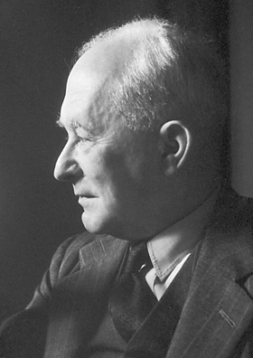
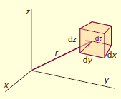
Born Interpretation
Classical wave equation:
Ψ(x,t) = Amplitude and |Ψ(x,t)|² = Intensity
Quantum mechanical system:
The state is completely specified by a wavefunction Ψ(x,t) ,which can be complex
All possible information can be derived from Ψ(x,t)
Intensity is equivalent to Probability.
|Ψ(x,t)|² = ρ(x), probability density.
|Ψ(x,t)|²dx = P(x), probability for finding the particle between x and x + dx
In 3 dimensions, P(x, y, z) = |Ψ(x,y,z,t)|²dτ

Slide 3
Laws of Quantum Mechanics
The average value of the observable corresponding to operator Â is
Classical correspondence: Average values for a distribution function P(x) :
Quantum mechanical analogue:

Slide 4
Normalization of Wavefunction
Since Ψ*Ψdτ is the probability, the total probability of finding the particle somewhere in space has to be unity
Divergent functions i.e.  ∞: Ψ can not be normalized, and therefore is NOT an acceptable wave function. However, a constant value C ≠ 1 is perfectly acceptable.
∞
Ψ
∞
x 
∞
∞
Ψ
x 
Unacceptable wavefunction
Ψ must vanish at ±∞, or more appropriately at the boundaries and Ψ must be finite

Slide 5
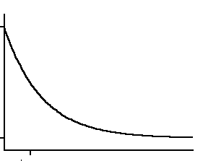
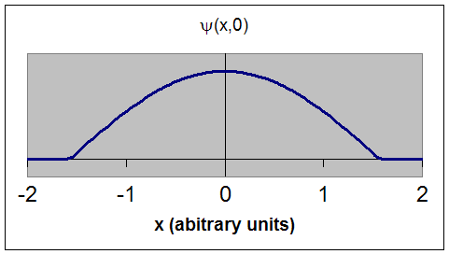
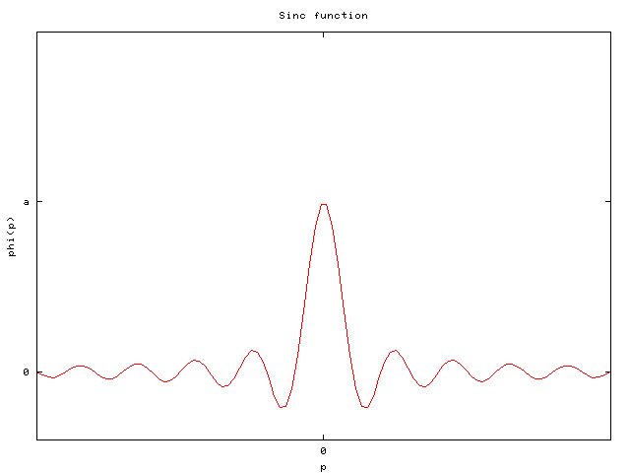
Acceptable wavefunctions

Slide 6
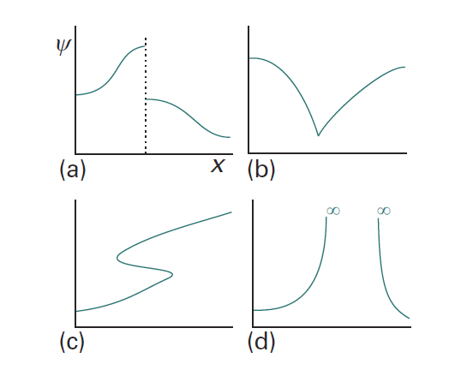
Restrictions on wavefunction
Unacceptable because ψ is not continuous
Unacceptable because dψ/dq is not continuous
Unacceptable because ψ is not single-valued
Unacceptable because ψ goes to infinity

Slide 7
Restrictions on wavefunction
ψ must be a solution of the Schrodinger equation
ψ must be normalizable: ψ must be finite and 0 at boundaries/ ±∞
Ψ must be a continuous function of x,y,z
dΨ/dq must be must be continuous in q
Ψ must be single-valued
Ψ must be quadratically-intergrable
(square of the wavefunction should be integrable)
Origin of quantization

Slide 8
Quantum Mechanics
Examples of Exactly Solvable Systems
Free Particle
Particle in a Square-Well Potential
Hydrogen Atom

Slide 9
Free Particle
Time-independent Schrodinger equation
For a free particle V(x)=0
There are no external forces acting

Slide 10
Free Particle
Second-order linear differential equation
Let us assume
Trial Solution

Slide 11
Free Particle
Second-order linear differential equation
Let us assume
Trial Solution

Slide 12
Free Particle

Slide 13
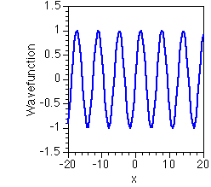
Free Particle
de Broglie wave
There are no restrictions on k
E can have any value
Energies of free particles are continuous
No Quantization All energies are allowed

Slide 14
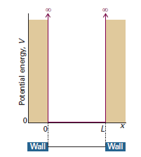
Particle in 1-D Square-Well Potential

